Slide 1


A Presentation for Educators
Notes:
Note: Slides #8 through #13 describe the supplemental CD2 Interest Exercise. If your state did not purchase this supplement, please hide these slides and do not cover them in your overview to educators.

Slide 2

CTC Logo: Balance your career and personal life to achieve success.
Slide 2
Notes:
I’m ________________and it is really a pleasure for me to present an overview of Career Direction2 to you. Thank you, Mr./Ms. _______________.
Today, I’m going to talk about Career Direction2 or CD2 – an interactive workshop for high school students that gives them information and strategies for planning for career satisfaction and success.
Notice the logo on the screen. This is the logo of Career Training Concepts, a 44-year-old company that works with teams of experts to create high quality instructional content, like CD2. They also publish the material and train members of the Army National Guard in communities across the nation. The Guard purchases the material from them so that members, like me, can facilitate CD2 in classrooms at no cost to schools.
This logo represents balance between career and personal life. What thoughts come to mind when you think of this balance?
Let a couple of audience members answer.
We want students to plan for happy and successful lives and we feel that is best accomplished by planning for a healthy balance.

Slide 3
Purpose
CD2 provides students with tools, strategies and knowledge needed to cultivate college and career readiness.
Slide 3
Notes:
CD2 enhances schools’ efforts toward getting students “college and career ready.”
College and career readiness includes:
self-awareness
research about options and costs regarding post-secondary education and careers
taking personal responsibility for preparing for the future
knowing how to get and keep a job
goal setting
healthy decision-making
These are all integrated into the CD2 workshop. Students even have the opportunity to create a tangible, action-plan of their own.
Now, let’s look closer at some of the highlights of CD2.

Slide 4
Highlights of Career Direction 2
Motivational career planning tool in
its 41st edition, reaching 6M+ students
Available at no cost to schools
Aligns with Common Core standards and American School Counselor Association (ASCA) guidelines
Notes:
With continuous updates and improvements throughout its 41 editions, CD2 has reached millions of students.
The National Guard supports its communities by providing high-quality resources at no cost to schools to help students become the best they can be. We also seek great citizens to serve with us in the National Guard. A Guard with people at their best benefits everyone.
CD2 is not “something extra” for students to learn. The content has been carefully aligned with standards so that you are wisely using valuable instructional time by providing students with a different source of critical concepts and skills.
Common Core Standards
For more information about Common Core standards, visit http://www.corestandards.org/.
Note: It’s a good idea to check your State Dept. of Education’s website to ensure that you have the most up-to-date info. In spring 2018, 41 states have adopted Common Core standards. The standards are learning goals for students (or what many have thoughtfully concluded that typically-developing children should learn at each grade level). A few states never adopted Common Core (e.g., NE, TX, AK, IN, SC, FL). Today, many states that once adopted Common Core standards have adapted them to better meet their own needs. Examples include GA, AL, PA, and UT.
Examples of Common Core standards and their relationship to CD2:
Reading Standard 3 involves analyzing a series of ideas -- the order and connections of these ideas. CD2 guides students through a series of steps for preparing for the future – taking many actions now that will positively impact future success.
Reading Standard 7 focuses on students being able to analyze accounts told in difference mediums. Info is presented through different mediums in CD2. For example, through text in the CD2 book and PPT slides, online resources, videos and discussion.
Writing Standard 4 relates to students’ abilities to plan and produce clear, coherent writing with editing for specific purpose and audience. CD2 integrates this standard as students build resume packages.
Writing Standard 6 involves the use technology to produce, publish, and update. Again, the CD2 online resume tool reinforces this standard.
Speaking & Listening Standard 1 concerns students participating effectively in a range of collaborative discussions while building on others' ideas and expressing their own clearly and persuasively. CD2 relates to this standard, because it is specifically designed to be a discussion-based workshop.
Speaking & Listening Standard 2 includes integrating multiple sources of information presented in diverse media or formats (e.g., visually, quantitatively, orally). Students’ learning is geared toward this standard while reading, writing, listening and speaking throughout the workshop.
ASCA guidelines
As most educators know, school counselors work under ASCA ethical guidelines. These include the following – all important to CD2:
Providing opportunities for all students to develop mindsets and behaviors necessary to learn work-related skills
Identifying resources needed to optimize education
Sharing info on college, career, and post-secondary options and helping students understand the importance of college and career readiness on their choices and opportunities.

Slide 5
Highlights of Career Direction 2 (continued)
Developed by a team of experts
for high school & college students
Comprehensive
Based on best practices
Notes:
The team of experts can be found on the title page of the CD2 student book.
CD2 is comprehensive in nature. It’s divided into 16 steps ranging from self-reflection about students’ own personal qualities as they relate to career choice, career and education options, ways to get motivated, strategies for landing and keeping a job, and staying on track by making healthy decisions.
CD2 was designed with best instructional practices in mind (e.g., opportunities for collaborative discussion, time for self-reflection, high-level questioning, age appropriate content connected to real-life, opportunities to apply strategies, and students are encouraged to extend their own learning by utilizing online resources found on the CD2 website: www.careertrain.com.

Slide 6
Highlights of Career Direction 2 (continued)
User-friendly, online password-protected resume tool
Guest instructor
Flexible scheduling
Notes:
You may want to offer to demonstrate the online resume tool (now or later) found at https://www.careertrain.com/student/resume_tool.
CD2 scheduling can be tailored to your needs. For example, I can focus on certain parts of CD2 or facilitate the presentation in its entirety, which is about 3 hours. We can work with various blocks of time, such as 60 or 90 minute class periods. Typically, we conduct this workshop over two or more days and with multiple classrooms.

Slide 7
Highlights of Career Direction 2 (continued)
Opportunities for follow-up activities
Red Ribbon Week and prom season
Focus on personal responsibility and
preparing for the future now
Notes:
Students’ books and CD2 online resources can be used for follow-up activities. For example, the book can be a students’ springboard for discussion with the school counselor and/or parents. It can also be used to complete an action plan and inspire areas for further research.
CD2’s section on healthy decision making is especially timely for Red Ribbon Week (a week in Oct. focused on bringing awareness to problems related to tobacco, alcohol, and drug use) and prom season, when there may be a higher likelihood of making choices around risky behaviors.
We encourage students to be proactive now in planning for their futures. For example, we stress that they can be their own financial aid director by researching resources on our website, thereby not waiting for parents or school counselors to do all the work.

Slide 8
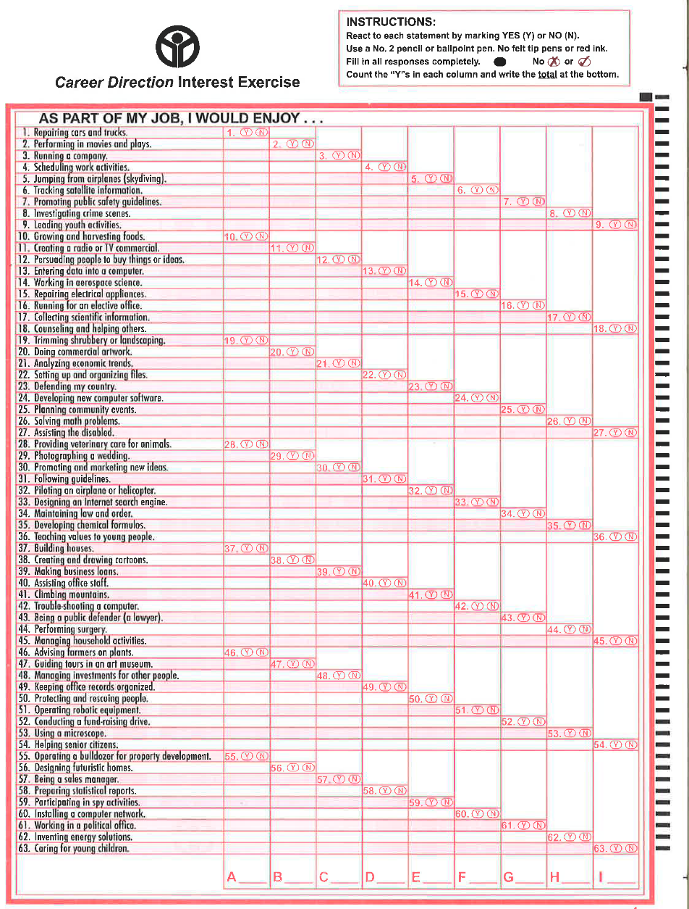
Interest Exercise Scanform
Easy to take in only 10 – 15 minutes
63 scientifically-validated statements divided into 9 career categories
Students simply bubble (Y) Yes or (N) No for each statement.
Notes:
The Interest Exercise is a supplement to Career Direction2. If your state did not purchase the Interest Exercise, please hide slides #8 through #13 and do not cover them in your overview to educators.
Another highlight of Career Direction2 is the Interest Exercise. As students consider future careers, we encourage each one to think about his/her priorities, personality, skills and interests. CD2 has a supplemental Interest Exercise that is administered with students early in the workshop. In about 10 minutes, students think about what they enjoy doing, as this is likely a good indicator of what they would enjoy doing in their career. As we know, career satisfaction and motivation to achieve are related to whether or not we enjoy what we’re doing.
Students simply read and react, by bubbling yes or no, to 63 statements. They then add up “yes” answers that fall within 9 columns (9 broad categories). Let’s take a look at how that works.

Slide 9
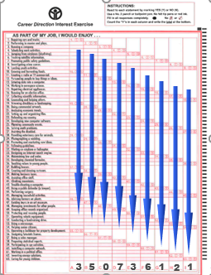
The Student Scanform
Students easily self-score by counting the number of “YES” answers for each column.
Students use their school’s password online to generate their personal Careers and Occupations Guide Report.
Notes:
The image on the slide shows how students compute their own scores by adding “yes” in each column. It’s very simple. Students then go to the Career Direction website, enter their school’s password as well as a personal self-created password. Each student enters the categories corresponding to their top 3 highest sums on their scanform to create a personal Careers and Occupations Guide Report. Let’s look at how this guide benefits students.

Slide 10
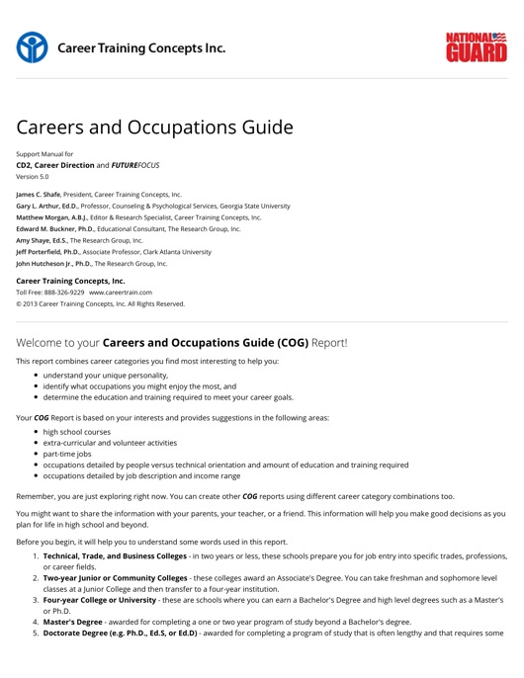
Personalized Student
Report
Based on individual interests
Provides suggestions for:
courses to take
extra-curricular activities
part-time jobs
career possibilities
Notes:
Students generate personalized Careers and Occupations Guide Reports that provide a detailed description of courses they may want to consider taking, extracurricular activities and part time jobs that may give them a head start with experience, as well as career options that relate to their
interests.

Slide 11
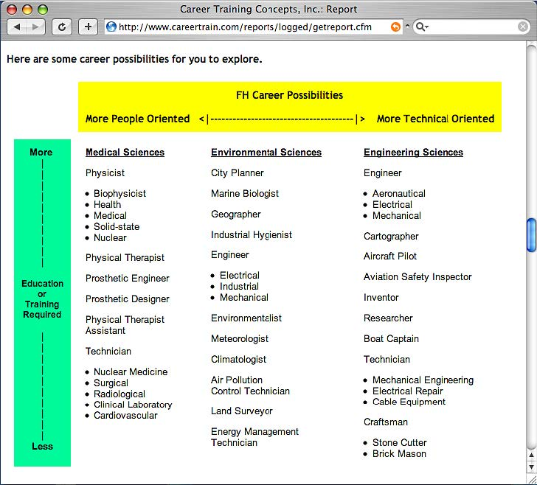
Personalized
Student
Report
Chart helps students think about possibilities related to level of education needed and personality.
Notes:
The list of suggested occupations found on the student report is in an easy-to-follow chart. The occupations are organized by level of education and personality type (i.e., People Oriented versus more Technically Oriented, on which students self-reflect in a previous step in the CD2 workshop)

Slide 12
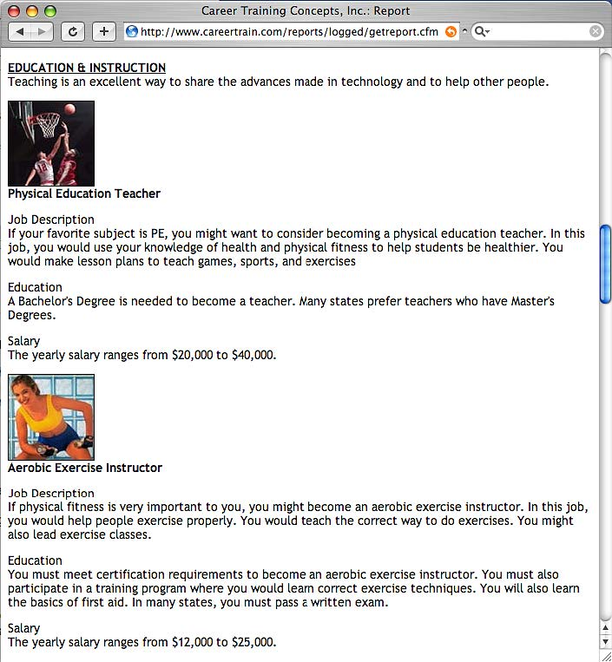
Personalized
Student
Report
Descriptions of jobs are provided, including responsibilities, education requirements, and salary range.
Notes:
The student report also describes the suggested jobs in terms of responsibilities, education requirements, and salary range.

Slide 13
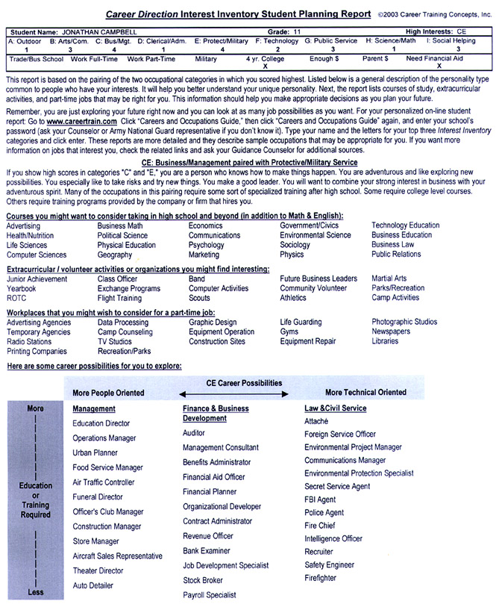
Educator’s Report
A “Student Planning Report” is emailed directly to the educator.
Recommends for each student:
Curriculum
Clubs/Activities
Part-time Jobs
Occupational
Choices
Notes:
Not only does each student generate a report, the educator receives them via email as well. This “Student Planning Report can augment your career guidance efforts with its suggestions of curriculum, extracurricular activities and career possibilities for each student.

Slide 14
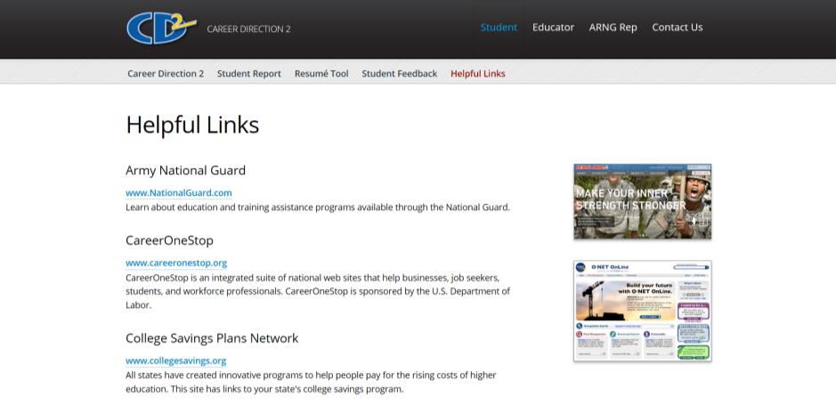
Online Resources for Students
Links on the CD2 website provide resources so students can continue their career-related research.
Notes:
One last highlight that I want to mention is the CD2 website, which provides students with links to many relevant resources so they can continue to research jobs that might be a good fit for them.

Slide 15
The following slides show a few highlights of Career Direction 2.

Slide 16

››› step 1 - 4
Success requires considering the following:
Priorities
Personality
Interest
Abilities
Slide 16
Notes:
Success is different for each of us and depends on personal qualities.
Take priorities, for instance. CD2 encourages students to think about what’s important to each of them. Maybe one student cares deeply about career success. Another may dream of doing work that helps their community or impacts the world through international work.
We also encourage students to spend time considering their unique personalities, interests and abilities as related to a possible career path.

Slide 17
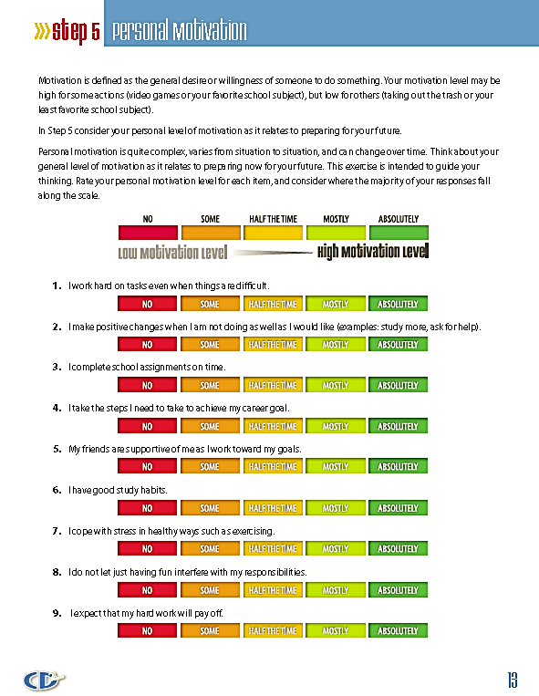
Personal Motivation
››› step 5
Students rate their motivation levels and discuss ways to boost motivation if needed.
Habits you build now…
can impact your success later!
Slide 17
Notes:
Each student explores where he/she is in terms of motivation for preparing for the future.
They rate themselves on nine positive mindsets and actions. The scale goes from No – Some – Half the Time – Mostly – Absolutely.
Students quickly see a visual representation of their motivation level. If they find themselves hovering near the lower end of the scale (in the red), we encourage them not to panic but to take action. We know motivation levels can change – sometime you just have to find the right interests, focus, and build some good habits.
We provide several tips that can help.

Slide 18

››› step 6
Sources of Training and Education
On-the-job training
Technical, trade and business colleges
Military services schools
Two-year junior or community colleges
Four-year colleges or universities
Slide 18
Notes:
In light of career goals, there are many options for education and training. Career goals will determine which source is best for each student. Students learn about advantages and disadvantages of each source.

Slide 19
Is Education Worth It?
Average estimated pre-tax monthly earnings for people who have:
Professional Degree
$6,980
Master’s Degree
Bachelor’s Degree
$4,624
Associate Degree
$3,276
High School Diploma
$2,768
No HS Diploma
$2,016
Source: Department of Labor
Slide 19
Notes:
Money isn’t everything, but it takes money to live! Students are often surprised by the numbers. As we know, earning potential typically increases with education level. The average income for someone who doesn’t finish high school makes for a very tight budget!
But the money they could earn as a doctor or lawyer would provide for lots of extras!
The point is for students to think about the career they want and get the education needed to be successful.
(Note: The numbers change every few years as new averages are computed by the Department of Labor, but what has not changed is the pattern. Higher degrees average higher income. The Census Bureau does not compute this type information every year.

Slide 20
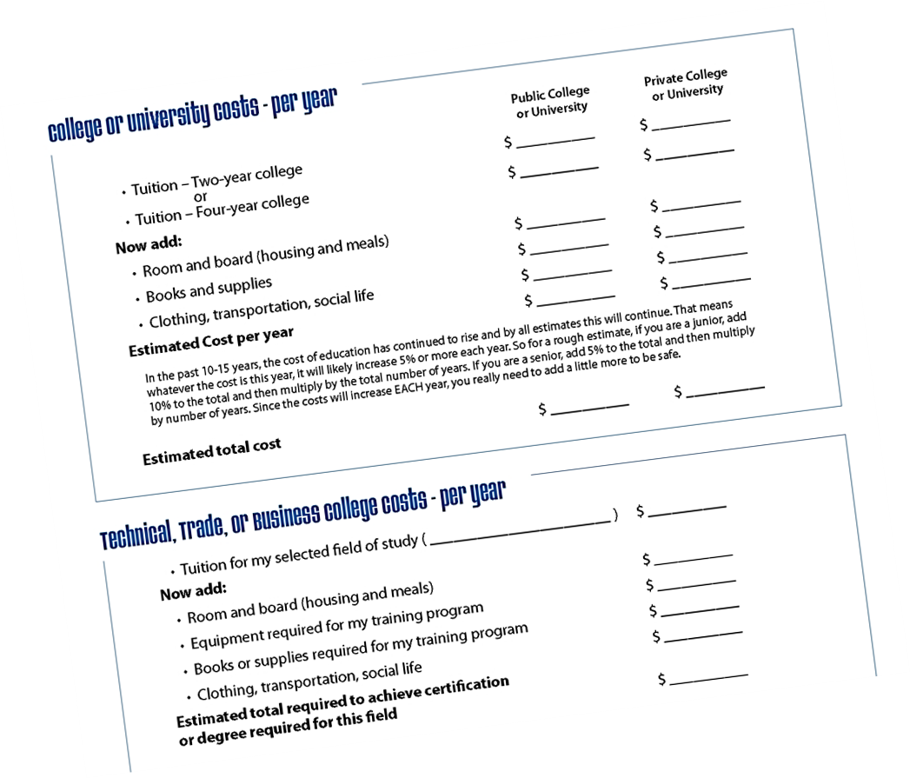
Training & Education Expense Worksheet
Do some homework and estimate costs
Students consider multiple sources of financial aid and ways to reduce costs.
Slide 20
Notes:
We advise students to go online to find out the costs for their preferred schools. We talk about the expenses (a real eye opener for many) and ways to make education more affordable. We suggest that they talk with their families about what they can afford.

Slide 21
››› step 7
Finding a Job: How? Where? Who?
Advertised Jobs
Invisible Jobs
Networking
Slide 21
Notes:
Finally – time to go to work – Finding a Job
Maybe during high school and college or trade school, and certainly after the post-secondary education and training – eventually, students will want to find a job (we hope). Finding a job can be a job in itself!
Some positions are advertised – all you have to do is check the newspaper, help wanted signs or websites. But because the jobs are advertised, you will have a lot of competition.
Other positions are “invisible” – not advertised. Employers often hire people they know, or referrals from people they trust.
There are two strategies we teach students for uncovering an “invisible” job.
Research an organization you are interested in working for.
Build of network of people who will help you find a job. We talk with students about practical ways to network.

Slide 22
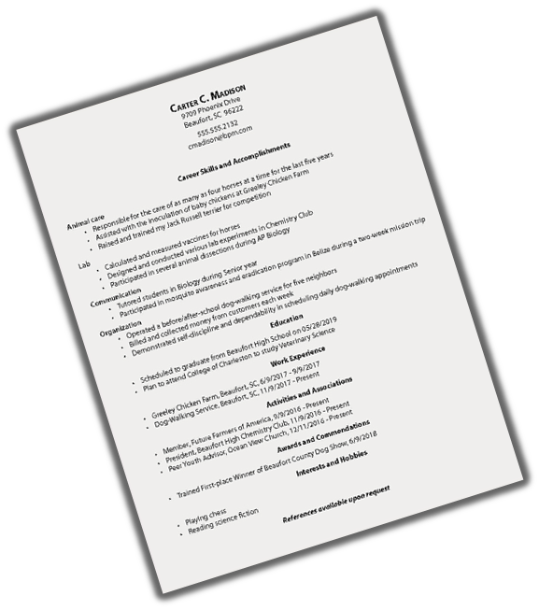
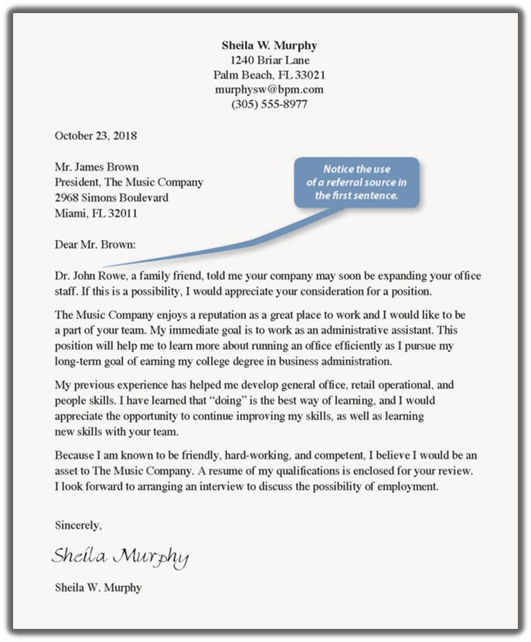
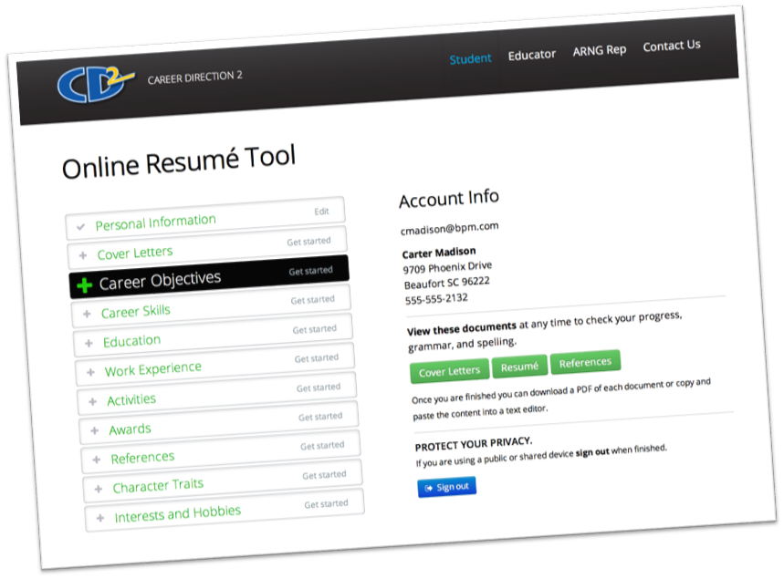
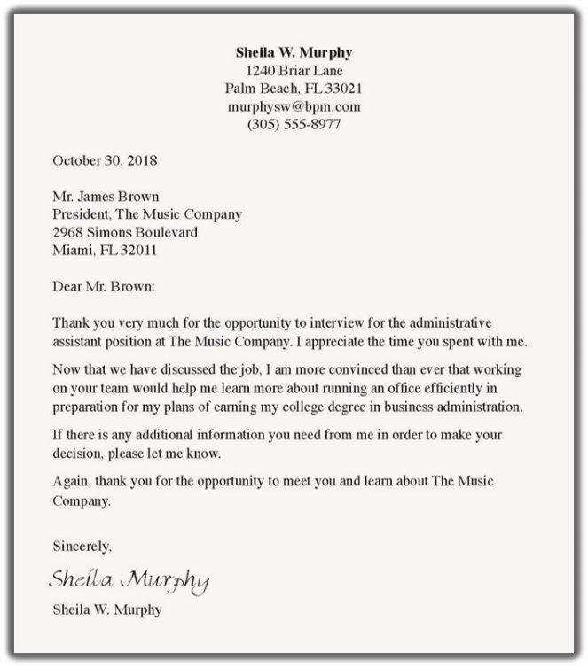
Resume, Cover Letter & Thank You Letter
››› step 8 - 11
Create your online profile to generate:
Functional Resume
Cover Letter
References (Ask permission first!)
Thank You Letter
Copy and paste in a Word document first and proofread.
Slide 22
Notes:
A student’s resume, cover letter, and job application are often their potential employer’s first impression of them! We want them to learn to make it work for them , NOT against them!

Slide 23
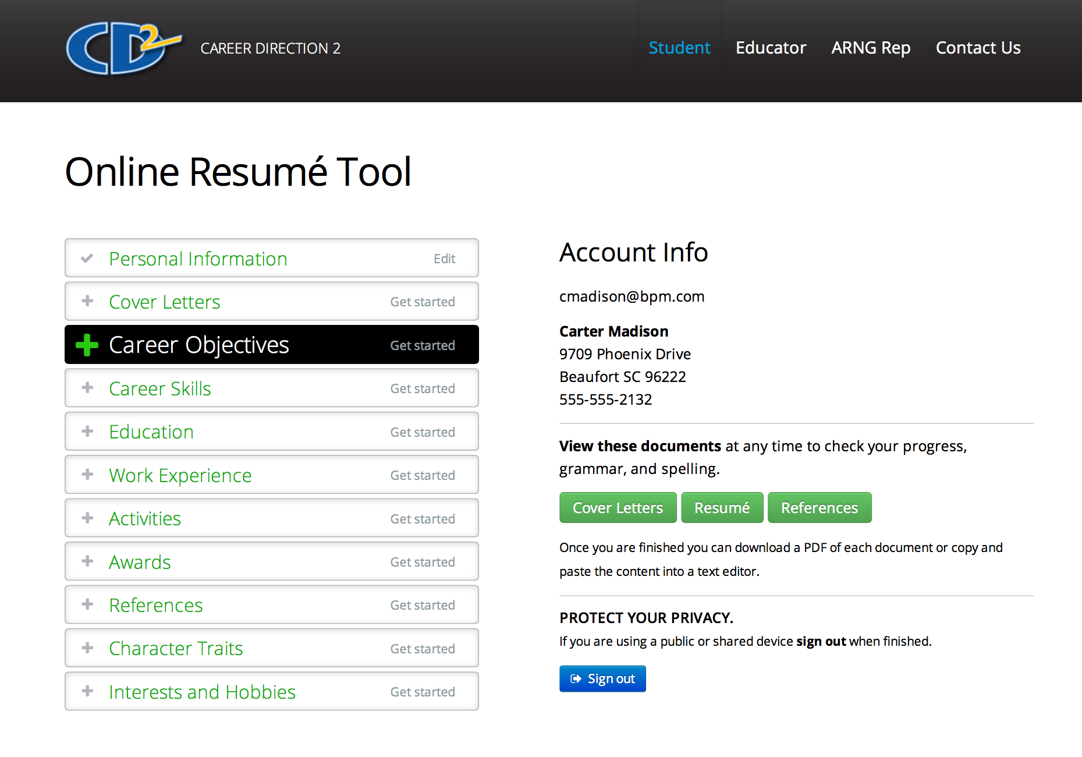
Career Direction Online Resume Tool
Create your online profile.
Accessible only by you
Password protected
Documents are stored 2 years
Pages 29-31 will help you complete the online Resume Tool. www.careertrain.com
Slide 23
Notes:
CTC has a FREE online tool for students to use in their job search. They go to www.careertrain.com, choose “Student” and then follow the instructions.
Their information is password-protected. Students use the school’s password, which I supply, to access the tool, and then they create their own passwords before beginning their work.
This tool stores their information for 2 years, and by law, they have to be over 13-years-old to use it.
Once they enter their information, they can create cover letters, resumes and thank you letters for different jobs and different companies.
All they need to do is copy the contents of these documents into a word processing program (like Microsoft Word), carefully proofread for spelling and grammar mistakes, make any changes, and print.

Slide 24
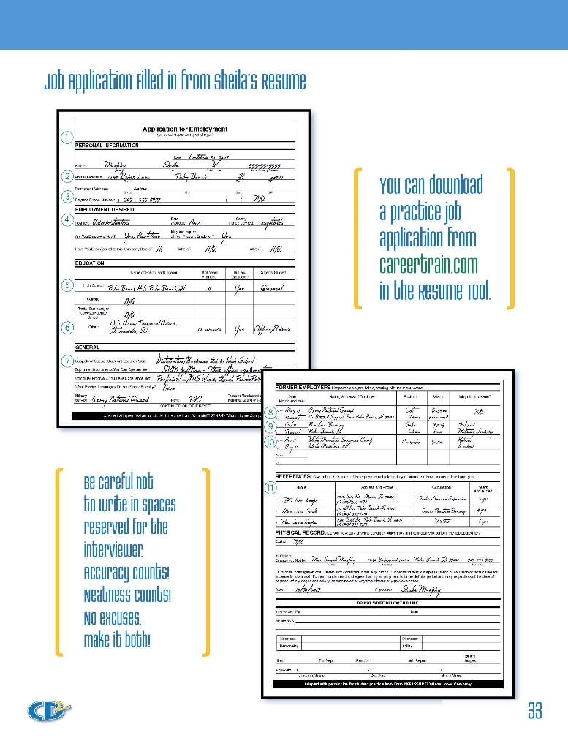

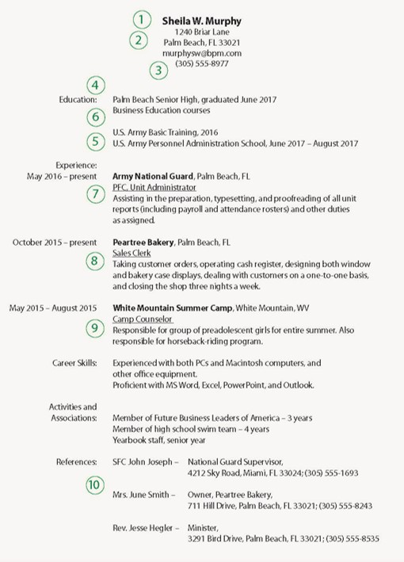
The Job Application
››› step 12
All the information you need is on your resume
Students can download a practice application from www.careertrain.com on the resume tool.
Slide 24
Notes:
Students also learn that once they have prepared their resume, filling out job applications is very easy.
They see how information for a standard application can be taken right from their resume.

Slide 25

Interviewing Strategies
››› step 13
Your purpose is simple –
Get an offer!
It will build your confidence, even if you don’t accept the job.
Slide 25
Notes:
If their cover letter, resume, and application have worked, the next step will be the interview.

Slide 26
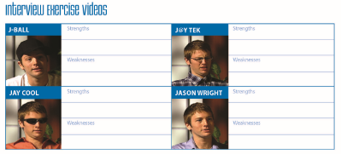
Evaluating Interviews
Students view, evaluate and discuss 4 videos showing different interviews.
Let’s take a look at 2 of the videos.
Slide 26
Notes:
Students discuss and evaluate 4 videos – each showing different interviews. The videos are pretty funny and students always seem to especially enjoy this part of the workshop.
For the sake of time, I want to share 2 of the 4 videos with you.

Slide 27


Evaluate an Interview
Jay Cool’s interview
Strengths?
Weaknesses?
Slide 27

Slide 28
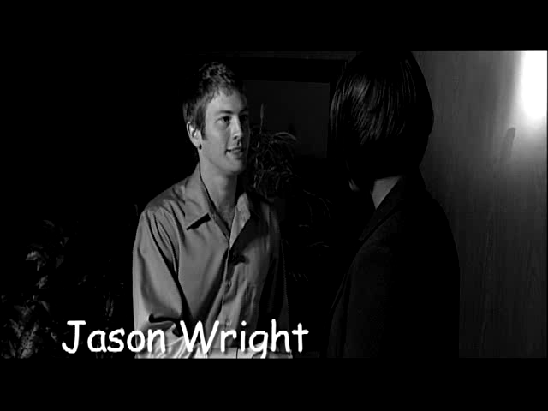

Evaluate an Interview
Evaluate Jason Wright on page 35
Strengths?
Weaknesses?
Jason Wright’s interview.
Strengths?
Weaknesses?
Slide 28

Slide 29

Keeping Your Job
››› step 14
Business Protocol – Keeping a Job
Meetings:
Be on time.
Pay attention.
Take notes.
Silence cell phones.
Texting, taking a phone call, or using a computer inappropriately
is rude.
Slide 29
Notes:
Once they have a good job, the challenge is to KEEP it! “Play by the rules” and the rules include “business etiquette” or in plain English – “manners.” So we provide students with tips like those listed above and others that include:
When you are introduced to someone, stand up, smile, make eye contact, say hello and offer a proper handshake.
As you deal with customers and co-workers, be helpful. Smile and offer assistance whenever you can.
Call your bosses and your customers by Mr. or Ms. unless they ask you to use their first names.
Saying “please, thank you,” is important! Get in the habit – please! And instead of “no problem” say “you’re welcome” or “my pleasure.”
Refrain from using text speak in written correspondence while at work.

Slide 30
Decision-Making Skills
››› step 15
YOU
You are responsible for your choices.
Not all your choices will be good.
People can help you make good choices.
• Parents • Teachers • Counselors
• Coaches • Ministers
Your decisions should be consistent with your priorities and the law.
Slide 30
Notes:
You’ve seen a glimpse of how we use CD2 to give students practical ways to make their futures successful.
BUT they need to know about potential career blockers, choices that could derail their chances for success.
We emphasize that each one makes their own lifestyle choices. Each will face the consequences, both good and bad.
But they don’t have to make their choices alone.
They can get advice from trustworthy people who have already faced the decisions they are facing.
I’ve heard that Mark Twain said, “When I was a boy of fourteen, my father was so ignorant I could hardly stand to have the old man around. But when I got to be twenty-one, I was astonished at how much the old man had learned in seven years.”
His father hadn’t gotten smarter, Mark Twain had grown up enough to know to listen a little.
This quote has been attributed to Mark Twain, but until the attribution can be verified, the quote should not be regarded as authentic. (Reader’s Digest, September 1937.)
Their decisions should reflect their priorities and be consistent with the law.

Slide 31
Decision-Making: Consider the Risks
Informed Decisions:
Potential for gain?
Potential for loss?
Is the potential for gain worth the risk?
Uninformed Decisions:
Living for the moment.
No thought of risk.
Can have lifelong (or life-short) consequences.
Versus
In order to make an informed decision, students must know the facts.
Slide 31
Notes:
Risk Management
It is why McDonalds has a carpet mat right inside the door on a rainy day. They minimize the risk of you falling, of you getting hurt, of them getting sued.
We can apply this principle in our decisions.
If students consider the consequences of the choices they face, they can make choices they’ll be proud of.
They need to answer three questions:
What are the potential gains?
What are the potential risks or losses?
Is the potential gain worth the potential risk?
Smart decisions are made when students grasp the risks.

Slide 32
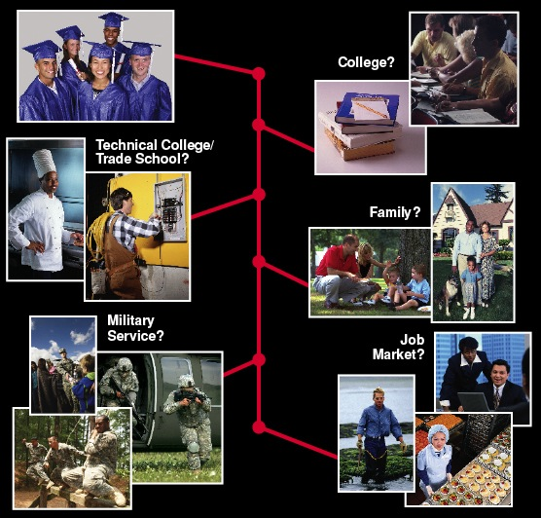
Your Plan of Action
››› step 16
A goal without a plan is a dream.
A dream without action is a fantasy.
Completing the steps outlined on pages 41 – 42 will ensure your career plans are real.
Slide 32
Notes:
To summarize, CD2 helps each student examine:
Priorities – what is important to him/her.
Interests – and the possible jobs that would be a good fit.
Education and training sources – to prepare for a successful career.
Job getting skills – to land a great job.
Informed decision-making skills – to avoid falling into a trap that derails the future.
On pages 41-42 in the student booklet, they have the format to begin creating their own plan of action. This can be a very valuable resource if they work their way through the questions and use the guide to help them formulate a plan – the plan that can lead to success by their own definition.

Slide 33

1-800-GO-GUARD
NationalGuard.com
Slide 33
Notes:
At the end of the presentation, I like to give a quick commercial about the National Guard.
And here it is...
The Guard serves your community and nation… we are citizen-soldiers who answer the call in natural disasters.
(Don’t take a lot of time here. You have already sold yourself and set the stage for the Guard as the provider of a valuable resource. Pushing now will undo your credibility.) This applies to this overview presentation to educators and also to the presentation to students.

Slide 34
For more information, please contact:
Insert RRNCO info here
Career Training Concepts, Inc.
Toll-free 888-326-9229
www.careertrain.com
Slide 34

